Slide 1

12
SHORT-RUN ECONOMIC FLUCTUATIONS

Slide 2
33
Aggregate Demand and Aggregate Supply

Slide 3

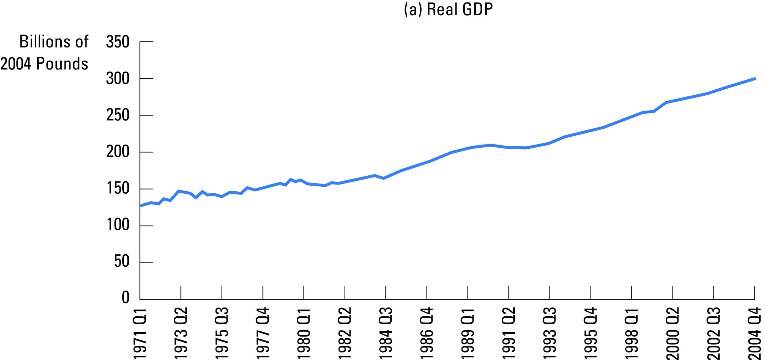
Figure 1 A Look At Short-Run Economic Fluctuations
Copyright © 2004 South-Western

Slide 4
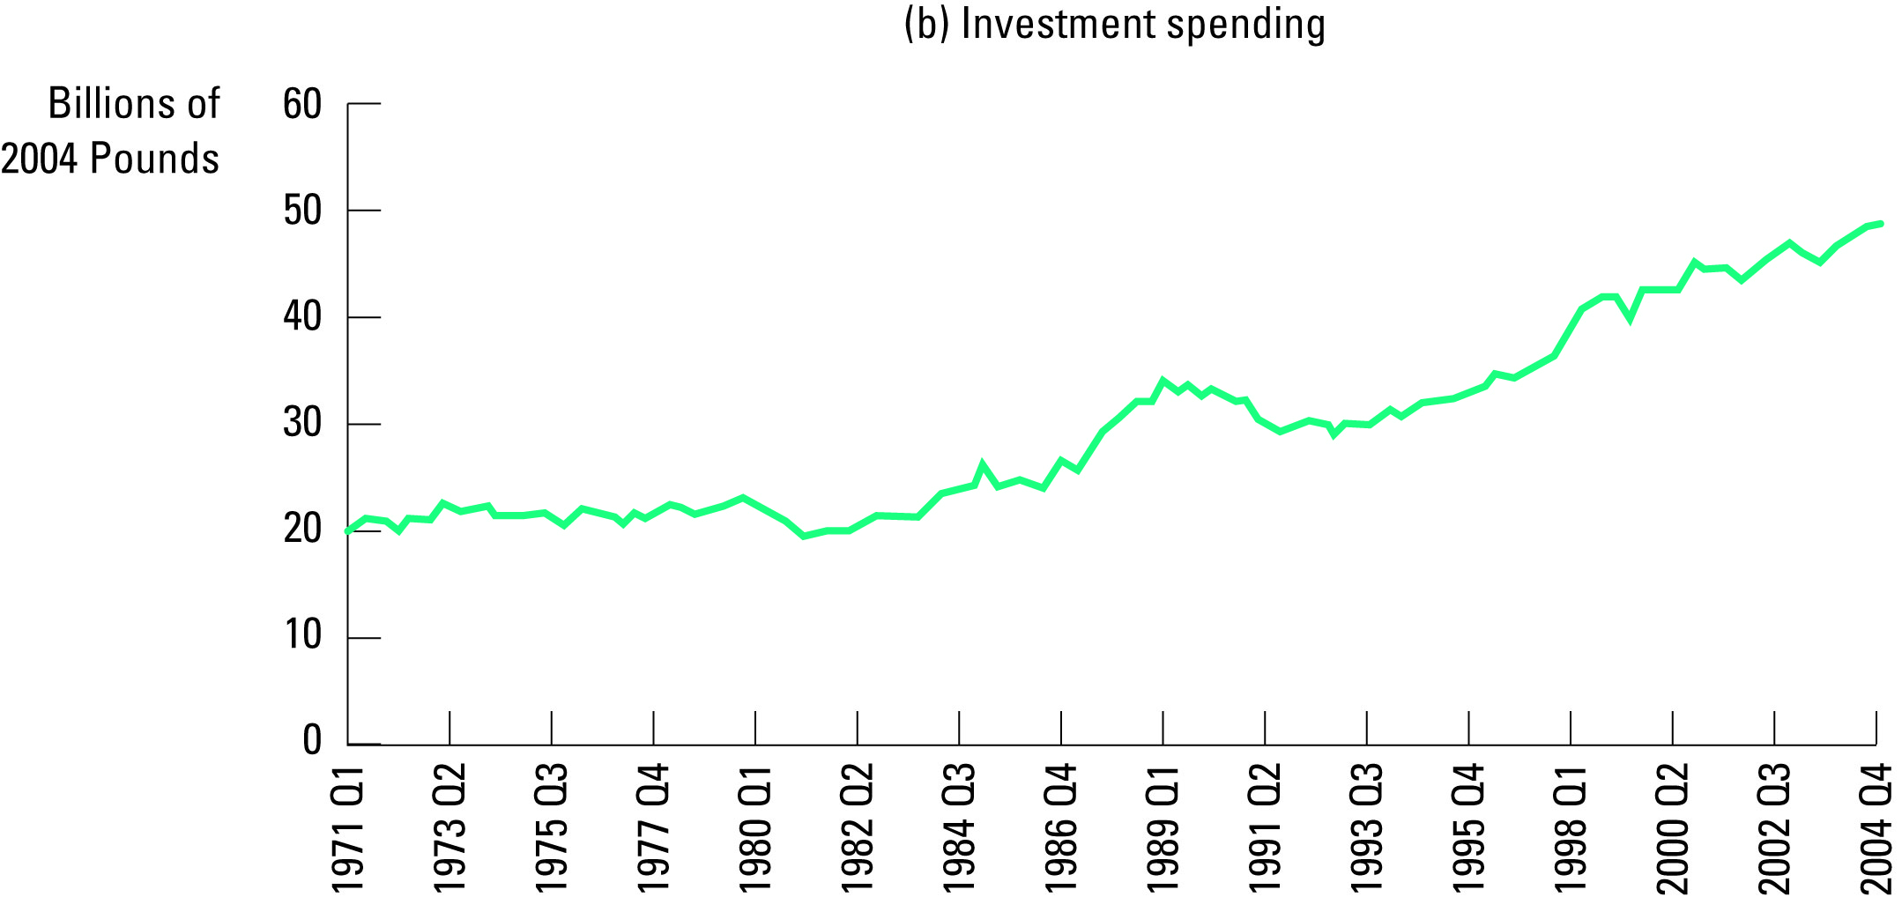
Figure 1 A Look At Short-Run Economic Fluctuations
Copyright © 2004 South-Western

Slide 5
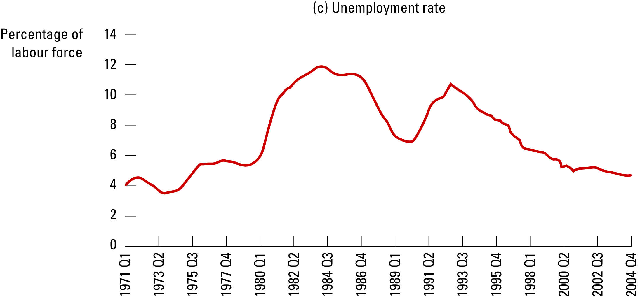
Figure 1 A Look At Short-Run Economic Fluctuations
Copyright © 2004 South-Western

Slide 6
Figure 2 Aggregate Demand and Aggregate Supply...
Price
Level
Aggregate
supply
Equilibrium
price level
Aggregate
demand
0
Equilibrium
Quantity of
output
Output
Copyright © 2004 South-Western

Slide 7
Figure 3 The Aggregate Demand Curve...
Price
Level
P
P₂
1. A decrease
Aggregate
in the price
demand
level . . .
0
Y
Y₂
Quantity of
Output
2. . . . increases the quantity of
goods and services demanded.
Copyright © 2004 South-Western

Slide 8
Figure 4 The Long-Run Aggregate Supply Curve
Price
Level
Long-run
aggregate
supply
P
P₂
2. . . . does not affect
1. A change
the quantity of goods
in the price
and services supplied
level . . .
in the long run.
0
Natural rate
Quantity of
of output
Output
Copyright © 2004 South-Western

Slide 9
Figure 5 Long-Run Growth and Inflation
2. . . . and growth in the
Long-run
money supply shifts
aggregate
aggregate demand . . .
supply,
LRAS
1980
LRAS
1990
LRAS
2000
Price
Level
1. In the long run,
technological
progress shifts
P
2000
long-run aggregate
4. . . . and
supply . . .
ongoing inflation.
P
1990
Aggregate
Demand,
AD
2000
P
1980
AD
1990
AD
1980
0
Y
1980
Y
1990
Y
2000
Quantity of
Output
3. . . . leading to growth
in output . . .
Copyright © 2004 South-Western

Slide 10
Figure 6 The Short-Run Aggregate Supply Curve
Price
Level
Short-run
aggregate
supply
P
P₂
1. A decrease
2. . . . reduces the quantity
in the price
of goods and services
level . . .
supplied in the short run.
0
Y₂
Y
Quantity of
Output
Copyright © 2004 South-Western

Slide 11
Figure 7 The Long-Run Equilibrium
Price
Level
Long-run
aggregate
supply
Short-run
aggregate
supply
Equilibrium
A
price
Aggregate
demand
0
Natural rate
Quantity of
of output
Output
Copyright © 2004 South-Western

Slide 12
Figure 8 A Contraction in Aggregate Demand
2. . . . causes output to fall in the short run . . .
Price
Level
Long-run
Short-run aggregate
aggregate
supply,
AS
supply
AS₂
3. . . . but over
time, the short-run
P
A
aggregate supply
curve shifts . . .
P₂
B
1. A decrease in
P₃
C
aggregate demand . . .
Aggregate
demand,
AD
AD₂
0
Y₂
Y
Quantity of
4. . . . and output returns
Output
to its natural rate.
Copyright © 2004 South-Western

Slide 13
Figure 10 An Adverse Shift in Aggregate Supply
1. An adverse shift in the short-
run aggregate supply curve . . .
Price
Level
Long-run
Short-run
aggregate
AS₂
aggregate
supply
supply,
AS
B
P₂
A
P
3. . . . and
the price
level to rise.
Aggregate demand
0
Y₂
Y
Quantity of
2. . . . causes output to fall . . .
Output
Copyright © 2004 South-Western

Slide 14
Figure 11 Accommodating an Adverse Shift in Aggregate Supply
1. When short-run aggregate
supply falls . . .
Price
Level
Long-run
Short-run
aggregate
AS₂
aggregate
supply
supply,
AS
P₃
C
2. . . . policymakers can
P₂
accommodate the shift
A
by expanding aggregate
3. . . . which
P
demand . . .
causes the
price level
to rise
4. . . . but keeps output
AD₂
further . . .
at its natural rate.
Aggregate demand,
AD
0
Natural rate
Quantity of
of output
Output
Copyright © 2004 South-Western

